Slide 1
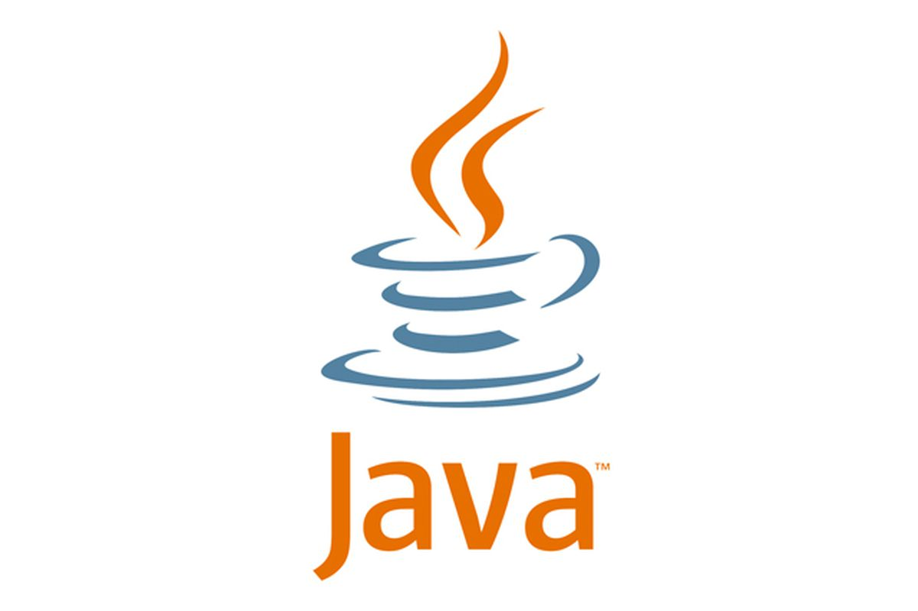
Basic Syntax
01
02
Java Programming Language
Data Types & Variables
03

Slide 2
Content
04
01
Course Introduction
05
02
Data Types and Variables
06
03
User Input

Slide 3
Content
01
02
03
04
Output Format
05
Common Mistakes
06
Operations

Slide 4

Alen Paunov
Alen has 12 years of experience as a teacher and lecturer in various fields and educational organizations. After 6 years of working in the legal services sector, he decides to dedicate himself to software technologies.
He has been an Educational Director in multiple academies and organizations. Throughout this time, he has successfully balanced the responsibilities of his position with his great passion for teaching.

Slide 5
01
Course Introduction
What is Programming, IDE, source code

Slide 6
Schedule
Essentials Syntax
Basic Syntax
Algorithmic Thinking
Entry Exam
Foundation Knowledge
Application Development
Final Exam
Interview

Slide 7
Programming Language
Written by people for people
Contains exact commands
Commands are reduced (compiled) to computer code
Performed unquestioningly by the computer
There are many programming languages:
Java, C#, JavaScript, Python, C++, C, PHP, Go, Swift и др.
Java was established in 1995.
Over the past 20 years, in the top three of the TIOBE Index**
https://www.tiobe.com/tiobe-index/

Slide 8

TIOBE Index – Java
2021
2016
2011
2006
2001
1996
2
1
28
1
1
3

Slide 9
What is IDE?
Integrated Development Environment (IDE)
The overall development environment
Code Editor
Debugger
Automation tools
Hinting and completing the code
Compiler
And other instruments
The Best Java Environment > IntelliJ Idea

Slide 10
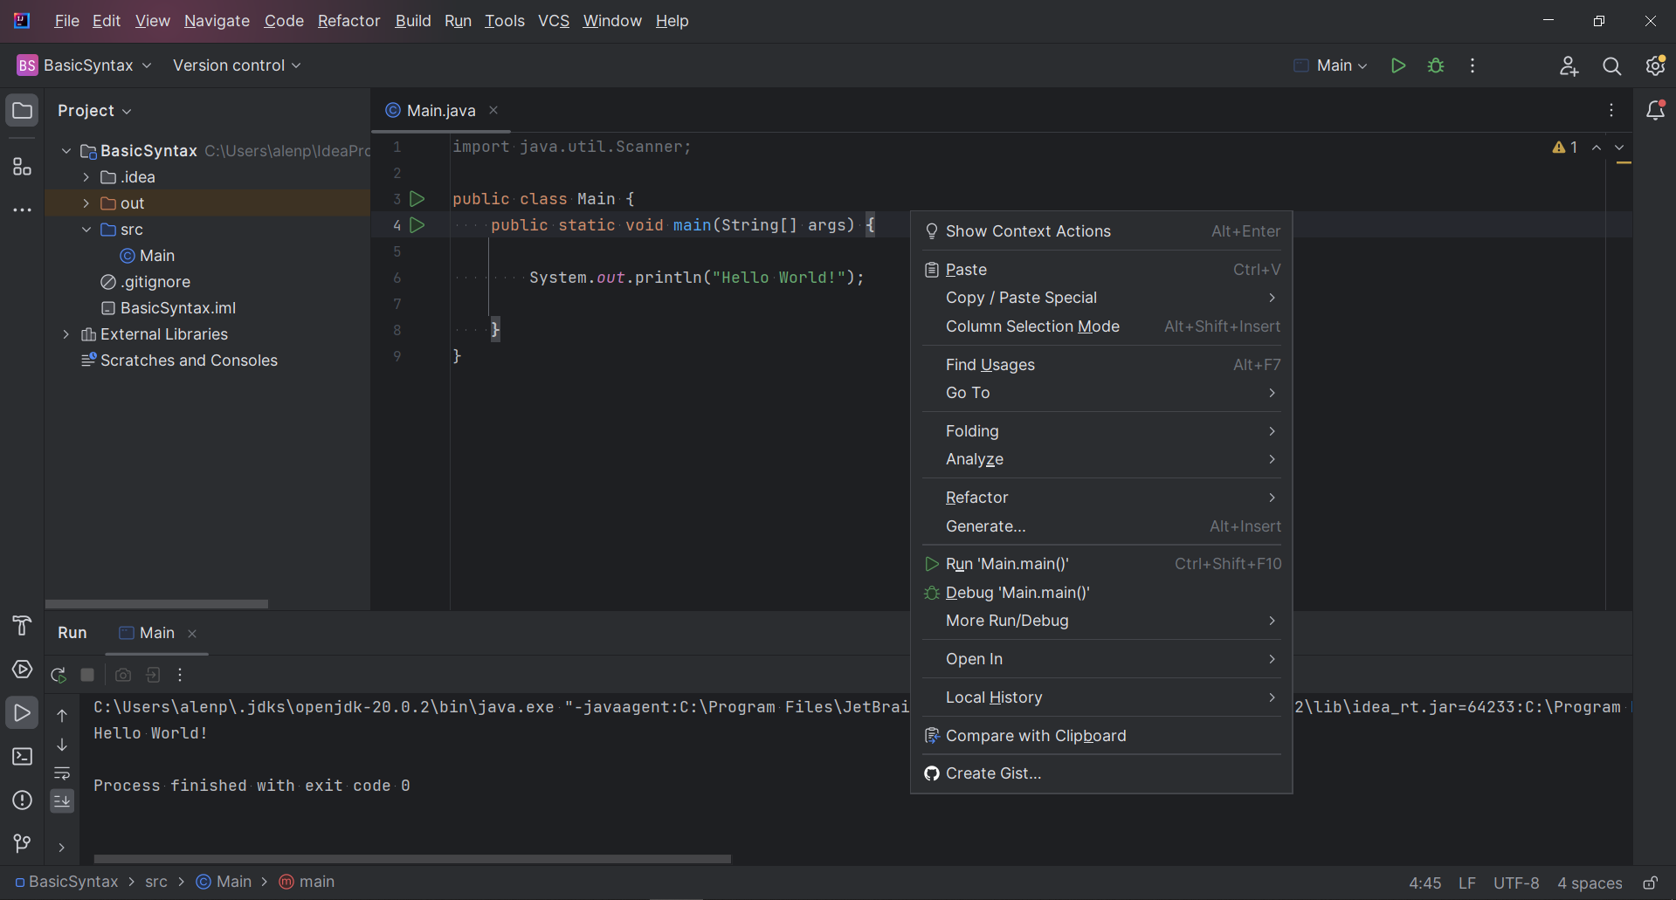
IDE
IntelliJ Idea
Navigation
Code editor
Project window
Menus
Output

Slide 11

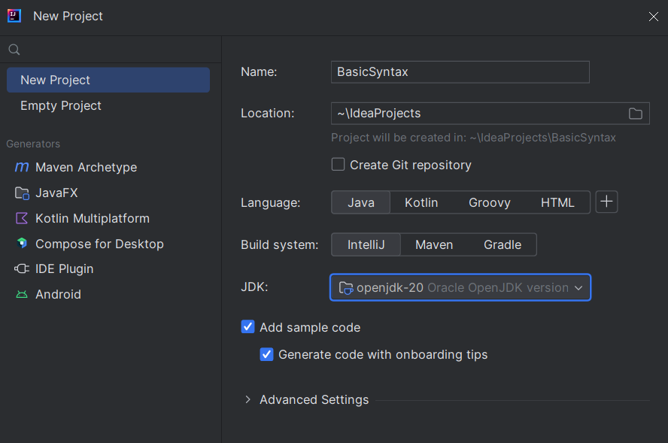
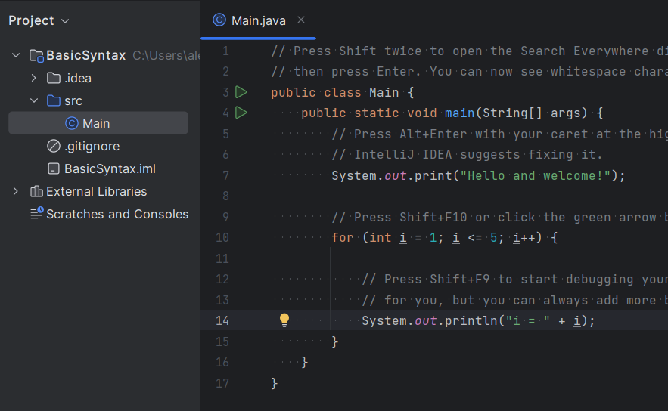
New Project
1
2
3

Slide 12
First Application
Elements of our program:
public class Main - our class (file)
public static void main - the starting point of our program
The class and the method are followed by an open and closed curly brace.
The execution code is written between the innermost opening and closing curly braces.

Slide 13
Code Example
public class Main {
public static void main(String[] args) {
System.out.println("Hello, world!");
}
}
Command end
Print command
Text to be printed

Slide 14
02
Data Types & Variables
Text. Numeric Types. Variables

Slide 15
Data Types
Every data type has a specific size (permissible values).
Different types of data (numbers, text) are stored in specific memory types.
They are named using keywords in Java.
23
"Java"
int
100
5
"A"
String

Slide 16
Data Types
According to the type of information stored in the computer's memory, data types vary:
Numeric
Integer numbers - byte, short, int, long
Floating-point numbers - double, float
Boolean type
boolean
Character
char
String (Text)
String
Object
Object
100
"Name"
3.14
"J"
true

Slide 17
Variables
In memory, data needs to be stored somewhere.
They are stored in containers of various sizes.
These containers are called variables.
Variables have a type, a name, and a value.
int number = 100;
type
value
name

Slide 18
Variables - Examples
We assign different data based on the type of the variable.
int number = 100;
long bigNumber = 70 000 000 000;
double floatingPoint = 3.14;
String name = "Java";
char symbol = 'J';
boolean isValid = true;
int

Slide 19
Task
Printing Numbers.
Create a variable of type "int".
Assign it a value of 100.
Print the value of the variable.
Repeat with type "double", with a value of 3.14.
*Tip - use the code for printing "Hello, world!" (instead of the text in parentheses, use the variable name)
*Don't forget the ";", to end the command.

Slide 20
Example
public class Main {
public static void main(String[] args) {
int number = 100;
System.out.println(number);
}
}

Slide 21
03
User Input
Reading from the Console

Slide 22
User Input
We can read user input from the console.
Store the data in a variable.
Work with the data and modify it.
Everything in the console is text.
We need to create a reader:
To read different types, we need to explicitly specify commands for them.
Scanner scanner = new Scanner(System.in);

Slide 23
Reading Different Data Types
Reading from the console
String text = scanner.nextLine();
Reading a character from the console:
char symbol = scanner.nextLine().charAt(0);
Reading an Integer from the console:
int number = Integer.parseInt(scanner.nextLine());
Reading a real number from the console:
double number = Double.parseDouble(scanner.nextLine());

Slide 24
05
Output Format
Formatting Numbers and Text

Slide 25
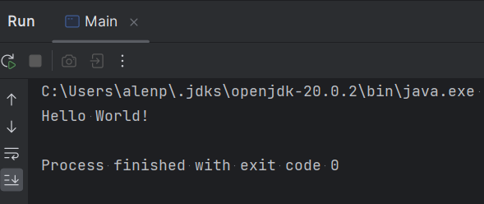
Output Format
We can print the data stored in variables to the console.
Printed Text

Slide 26
Print Output
We print using a specific command.
Print and download the cursor on the next line:
System.out.println("Hello, world");
Print and cursor remains on the same line:
System.out.print("Hello, world");
Print variable:
System.out.println(number);

Slide 27
Format Output
Using templates: %s – String %c – char %d – int / long %f – double / float
Task: Write a program that reads from the user city and degrees and displays the following message on the console: "Today in {town} it is {degrees} degrees."

Slide 28
Example
public static void main(String[] args) {
Scanner scanner = new Scanner(System.in);
String town = scanner.nextLine();
int degrees = Integer.parseInt(scanner.nextLine());
System.out.printf("Today in %s it is %d degrees.", town, degrees);
}

Slide 29
Rounding
Round to the next (larger) integer:
double up = Math.ceil(3.14); //4.00
Round to the previous (lower) integer:
double down = Math.floor(3.14); //3.00
Print variable:
System.out.printf("%.3f", 3.14159); //3.142

Slide 30
05
Common Mistakes

Slide 31
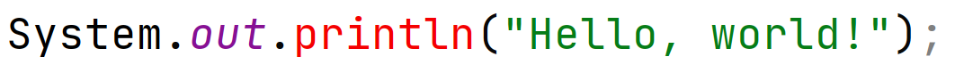
Common Mistakes
Outside the "main" method
Lack of ";"
Lack of ")"
Lowercase (System)
Capital letter (println)
Lack of quotation mark

Slide 32
06
Operations
Operators +, -, *, /

Slide 33
Operations
Operations with a number
public static void main(String[] args) {
int a = 10;
int b = 5;
System.out.println(a + b); //15
System.out.println(a - b); //5
System.out.println(a * b); //50
System.out.println(a / b); //2
}

Slide 34
Operations
The result can be stored in a variable:
public static void main(String[] args) {
int a = 10;
int b = 5;
int sum = a + b;
System.out.println(sum); //15
}
*The variable must be the same type so we don't lose data

Slide 35
Edge Cases
Division with integer and real number
Division with 0
int num = 7;
System.out.println(num / 2); //3
System.out.println(num / 2.0); //3.5
int num = 7;
System.out.println(num / 0); //Error
System.out.println(num / 00,); //Infinity
System.out.println(0.0 / 00,); //NaN

Slide 36
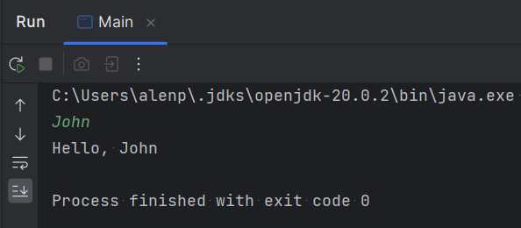
Text operations
Concatenating text with an operator " + " is called concatenation
Scanner scanner = new Scanner(System.in);
String name = scanner.nextLine();
System.out.println("Hello, " + name);
The result is a combination of the two texts.

Slide 37
Edge Case
Concatenation of text and number
double a = 3.14;
double b = 5.35;
System.out.println("The sum is: " + a + b);

